Slide 1
Introducing Astro: A next-generation framework for building lightning-fast, content-focused websites.
Nashtech .
20th Jun 2025

Slide 2
Introducing & Context
What is Astro?
The problem it solves
Core features & Innovations
Developer Experience
Use cases & Real-world examples
Demo
Q&A

Slide 3
01
Introducing & Context

Slide 4
Introducing Rust
What is Rust?
A modern, systems-level programming language created by Mozilla (2010).
Focused on performance, safety, and concurrency.
Combines the speed of C/C++ with modern developer ergonomics.
Notes:
Component là một đơn vị độc lập trong phần mềm, có thể được tái sử dụng và kết hợp với các component khác để xây dựng ứng dụng lớn hơn.

Slide 5
Introducing Rust
Core Features of Rust
Memory Safety without Garbage Collection
Zero-Cost Abstractions – high-level code with no runtime overhead.
Fearless Concurrency – safe multithreading with compiler guarantees.
Cross-Platform – runs on servers, embedded devices, and everywhere in between.
Notes:
Component là một đơn vị độc lập trong phần mềm, có thể được tái sử dụng và kết hợp với các component khác để xây dựng ứng dụng lớn hơn.

Slide 6
Introducing Rust
Why Rust Matters Today
Chosen by developers as the “most loved language” (Stack Overflow Survey, multiple years).
Increasing adoption in cloud, web backends, systems programming, and blockchain.
Bridges the gap: high performance like C++, developer safety like Python/Go.
Notes:
Component là một đơn vị độc lập trong phần mềm, có thể được tái sử dụng và kết hợp với các component khác để xây dựng ứng dụng lớn hơn.

Slide 7


Introducing Rust
Variables & Type in Rust
Common types: integers, floats, bool, char, string, tuples, arrays
Immutable by default
Strongly typed, with inference
Notes:
Component là một đơn vị độc lập trong phần mềm, có thể được tái sử dụng và kết hợp với các component khác để xây dựng ứng dụng lớn hơn.

Slide 8
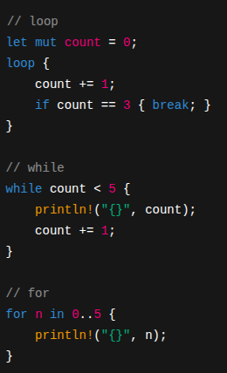
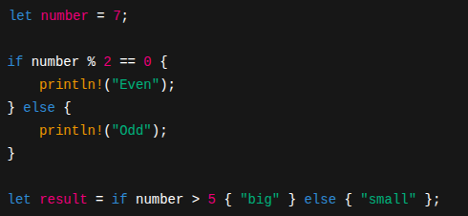
Introducing Rust
Conditions and Loop
If else and loop in Rust
Notes:
Component là một đơn vị độc lập trong phần mềm, có thể được tái sử dụng và kết hợp với các component khác để xây dựng ứng dụng lớn hơn.

Slide 9
02
Introducing Actix-web

Slide 10
Introducing Actix-web
What is Actix-web?
A powerful, pragmatic web framework for Rust
Built on top of the Actix actor system
Focused on speed, flexibility, and reliability
Ideal for building APIs, microservices, and full web apps
Notes:
Component là một đơn vị độc lập trong phần mềm, có thể được tái sử dụng và kết hợp với các component khác để xây dựng ứng dụng lớn hơn.

Slide 11
Introducing Actix-web
Key Features
Blazing fast → consistently tops web framework benchmarks
Asynchronous by default → built on Rust’s async/await
Lightweight & modular → only import what you need
Type-safe requests & responses
Notes:
Component là một đơn vị độc lập trong phần mềm, có thể được tái sử dụng và kết hợp với các component khác để xây dựng ứng dụng lớn hơn.

Slide 12
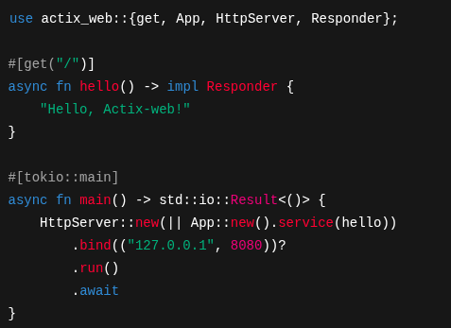
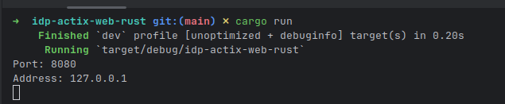
Introducing Actix-web
Example: Minimal Server
Notes:
Component là một đơn vị độc lập trong phần mềm, có thể được tái sử dụng và kết hợp với các component khác để xây dựng ứng dụng lớn hơn.

Slide 13
Introducing Actix-web
Why Use Actix-web?
Performance → among the fastest web frameworks
Safety → memory safety from Rust, fewer runtime crashes
Scalability → handles thousands of concurrent requests
Community & Ecosystem → strong libraries and active contributors
Notes:
Component là một đơn vị độc lập trong phần mềm, có thể được tái sử dụng và kết hợp với các component khác để xây dựng ứng dụng lớn hơn.

Slide 14
03
The web development landscape to day

Slide 15
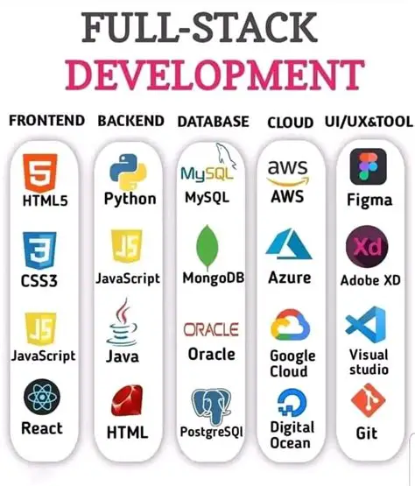
The web development landscape today
Current Trends
High demand for performance → real-time apps, APIs, streaming, AI backends
Microservices & APIs dominate modern architectures
Cloud-native deployment is the standard (Docker, Kubernetes, serverless)
Polyglot ecosystems → teams mix languages & frameworks
Notes:
What It Is: Loop components are reusable pieces of content (e.g., tables, lists, notes, or task trackers) that can be embedded and synced across Microsoft 365 apps like Teams, Outlook, and Word.
Why It Matters: Instead of copying and pasting information, components stay updated in real time wherever they’re used. For example, a project task list in Loop will automatically update if edited in Teams or Outlook.
Example: "Create a task list in Loop, share it in a Teams chat, and watch it update in real time as team members make changes."

Slide 16
The web development landscape today
Common Tools & Limitations
Node.js / Express → easy to start, but single-threaded bottlenecks
Python / Django / Flask → great ecosystem, but slower under heavy load
Java / Spring → robust, but heavy and verbose for smaller services
Go → fast and simple, but less safety around memory and types
Notes:
What It Is: Loop components are reusable pieces of content (e.g., tables, lists, notes, or task trackers) that can be embedded and synced across Microsoft 365 apps like Teams, Outlook, and Word.
Why It Matters: Instead of copying and pasting information, components stay updated in real time wherever they’re used. For example, a project task list in Loop will automatically update if edited in Teams or Outlook.
Example: "Create a task list in Loop, share it in a Teams chat, and watch it update in real time as team members make changes."

Slide 17
The web development landscape today
The Need for Something New
Developers want performance + safety + productivity in one stack
Traditional frameworks often force a trade-off:
Fast ⚡ but unsafe ❌
Safe ✅ but slow 🐢
Rust + Actix-web emerges as a solution:
High performance like C/Go
Memory safety without garbage collection
Modern async programming
Notes:
What It Is: Loop components are reusable pieces of content (e.g., tables, lists, notes, or task trackers) that can be embedded and synced across Microsoft 365 apps like Teams, Outlook, and Word.
Why It Matters: Instead of copying and pasting information, components stay updated in real time wherever they’re used. For example, a project task list in Loop will automatically update if edited in Teams or Outlook.
Example: "Create a task list in Loop, share it in a Teams chat, and watch it update in real time as team members make changes."

Slide 18
04
Why Rust + Actix-web together?

Slide 19
Why Rust + Actix-web together?
Rust Strengths
Performance → Compiles to native code, no VM overhead
Memory Safety → Prevents crashes and security bugs at compile time
Concurrency → Fearless multithreading with compiler guarantees
Growing Ecosystem → Modern tooling (Cargo, Crates.io)

Slide 20
Why Rust + Actix-web together?
Actix-web Strengths
Blazing Fast → tops independent benchmarks for web frameworks
Async by Default → built on Rust’s async/await
Lightweight & Modular → build minimal or full-featured apps
Production-Ready → stable, mature, widely used in real projects

Slide 21
Why Rust + Actix-web together?
Rust provides the foundation: speed + safety + concurrency
Actix-web provides the framework: ergonomic web server + routing + middleware
Together:
Handle thousands of concurrent requests safely
Build apps that are both developer-friendly and production-grade
No compromise between productivity, performance, and reliability
Why Together?

Slide 22
05
Benefits

Slide 23
Benefits
Performance Benefits
⚡ High throughput → among the fastest web frameworks in benchmarks
🧵 Scales with concurrency → handles thousands of requests safely
🏎️ Low-level efficiency → compiled to machine code, no garbage collector overhead
Notes:
What It Means: Loop enables real-time collaboration, allowing team members to work together more effectively, regardless of location.
Why It Matters: This reduces delays caused by waiting for feedback or updates and ensures everyone is aligned.
Example: "Instead of sending multiple versions of a document back and forth, we can all edit the same Loop component in real time."

Slide 24
Benefits
Safety & Reliability
✅ Memory safety guaranteed → no nulls, buffer overflows, or data races
🔒 Security by design → Rust eliminates many common vulnerabilities
🛠️ Type safety → catch bugs at compile time instead of runtime
Notes:
What It Means: Loop enables real-time collaboration, allowing team members to work together more effectively, regardless of location.
Why It Matters: This reduces delays caused by waiting for feedback or updates and ensures everyone is aligned.
Example: "Instead of sending multiple versions of a document back and forth, we can all edit the same Loop component in real time."

Slide 25
Benefits
Developer Productivity
📦 Cargo & Crates.io → modern package manager & ecosystem
🔄 Async/await ergonomics → clean concurrency handling
🧩 Modular design → build minimal microservices or full web apps
🚀 Fast prototyping + production-ready stability
Notes:
What It Means: Loop enables real-time collaboration, allowing team members to work together more effectively, regardless of location.
Why It Matters: This reduces delays caused by waiting for feedback or updates and ensures everyone is aligned.
Example: "Instead of sending multiple versions of a document back and forth, we can all edit the same Loop component in real time."

Slide 26
06
Limitations & Trade-offs

Slide 27
Limitations & Trade-offs
Learning Curve
📘 Rust is harder to learn than Python/JavaScript
Ownership & borrowing concepts can feel challenging
Slower onboarding for teams new to systems programming
Notes:
What It Means: Loop enables real-time collaboration, allowing team members to work together more effectively, regardless of location.
Why It Matters: This reduces delays caused by waiting for feedback or updates and ensures everyone is aligned.
Example: "Instead of sending multiple versions of a document back and forth, we can all edit the same Loop component in real time."

Slide 28
Limitations & Trade-offs
Ecosystem Maturity
🧩 Ecosystem is younger than Node.js, Python, or Java
Fewer high-level libraries & tooling compared to mature stacks
Some integrations (ORMs, templating, etc.) still evolving
Notes:
What It Means: Loop enables real-time collaboration, allowing team members to work together more effectively, regardless of location.
Why It Matters: This reduces delays caused by waiting for feedback or updates and ensures everyone is aligned.
Example: "Instead of sending multiple versions of a document back and forth, we can all edit the same Loop component in real time."

Slide 29
Limitations & Trade-offs
Development Speed vs. Safety
🛡️ Compiler checks = fewer runtime errors
⏳ But stricter compiler = more time upfront to satisfy borrow checker
⚖️ Trade-off: Slower initial development, faster long-term stability
Notes:
What It Means: Loop enables real-time collaboration, allowing team members to work together more effectively, regardless of location.
Why It Matters: This reduces delays caused by waiting for feedback or updates and ensures everyone is aligned.
Example: "Instead of sending multiple versions of a document back and forth, we can all edit the same Loop component in real time."

Slide 30
Limitations & Trade-offs
Operational Considerations
👩‍💻 Smaller talent pool compared to mainstream languages
🛠️ Debugging & tooling less polished than older ecosystems
📉 For small/simple apps, Rust + Actix may be overkill compared to lightweight scripting frameworks
Notes:
What It Means: Loop enables real-time collaboration, allowing team members to work together more effectively, regardless of location.
Why It Matters: This reduces delays caused by waiting for feedback or updates and ensures everyone is aligned.
Example: "Instead of sending multiple versions of a document back and forth, we can all edit the same Loop component in real time."

Slide 31
06
Demo

Slide 32
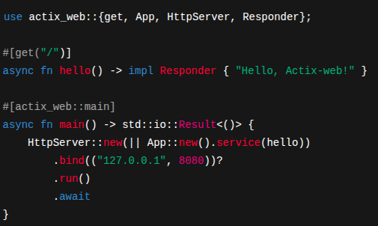
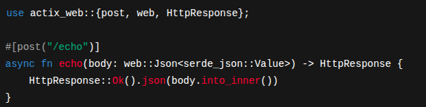
Demo - Building
Step 1: Create project cargo new --bin actix_demo && cd actix_demo
Step 2: Add dependencies (cargo.toml)
Step 3: Write a minimal server src/main.rs
Step 4: Run locally cargo run
Step 5: Add a JSON endpoint
https://github.com/nvhai248/idp-actix-web-rust
Notes:
What It Means: Loop keeps all project-related content (notes, tasks, documents) in one place, reducing the need to switch between apps.
Why It Matters: This saves time and ensures nothing gets lost or overlooked.
Example: "Instead of searching through emails, Teams chats, and shared drives, everything we need is in the Loop workspace."

Slide 33
07
Q&A

